Slide 1
Nested Queries
Simple Nested Queries
Use of Set Operations (Union , Intersect)

Slide 2
IN Operator
The IN operator allows you to specify multiple values in a WHERE clause.
The IN operator is a shorthand for multiple OR conditions
SELECT CNIC, Name , GPA
FROM Student
WHERE Name IN( 'Maria' , 'Maida','Madiha');
Student
CNIC | Name | Address | GPA | Did

Slide 3
IN Operator – Same Queries.
SELECT CNIC, Name , GPA
FROM Student
WHERE Name IN( 'Maria' , 'Maida','Madiha’);
SELECT CNIC, Name , GPA
FROM Student
WHERE Name = 'Maria’ or Name = 'Maida’ or Name = 'Madiha';
Student
CNIC | Name | Address | GPA | Did

Slide 4
Example
Show employees names who are working on project number 1 or 2 or 3 or 10.
= OR
Select fname
From employee join works_on on essn = ssn
Where pno in (1,2,3,10)

Slide 5
Sub query / Nested Query / Inner Query
A Nested query is a query within another SQL query and is embedded within the WHERE clause.
Select
From
Where attribute IN (
Select
From
Where
)

Slide 6
Sub query / Nested Query / Inner Query
A subquery is used to return data that will be used in the main query as a condition to further restrict the data to be retrieved.
Select
From
Where attribute IN (
Select
From
Where
)

Slide 7
Example
Show all employees who are working in research department.
Select *
From employee
Where dno in ( select dnumber
From department
Where dname = research );

Slide 8
Example
Show all employees who are working in a project
Select *
From employee
Where ssn in ( select essn
From works_on);

Slide 9
Example
Show all employees who are working in a project located in stafford.
Select *
From employee
Where ssn in ( select essn
From works_on
Where pno in ( select Pnumber
From project
Where location = ‘stafford’));

Slide 10
Key word NOT IN
We can use NOT IN in similar manner as we used IN.
Show employees who are not managers.
Select *
From employee
Where ssn not in ( select mgrssn
From department
);

Slide 11
Set Operation

Slide 12
Set Operation
Union [UNION]
Union All [UNION ALL]
Intersection [IN]
Difference [NOT IN]
A(1, 2, 3, 6) B (1, 3, 4, 5)
A U B(1,2,3,4,5,6)
A ⋂ B = (1, 3)
A – B = ( 2, 6) B – A = (4, 5)
AUB = B U A
A ⋂B = B ⋂ A
A – B != B – A

Slide 13
Union
Sql gives us a keyword of union to achieve the desired results.

Slide 14
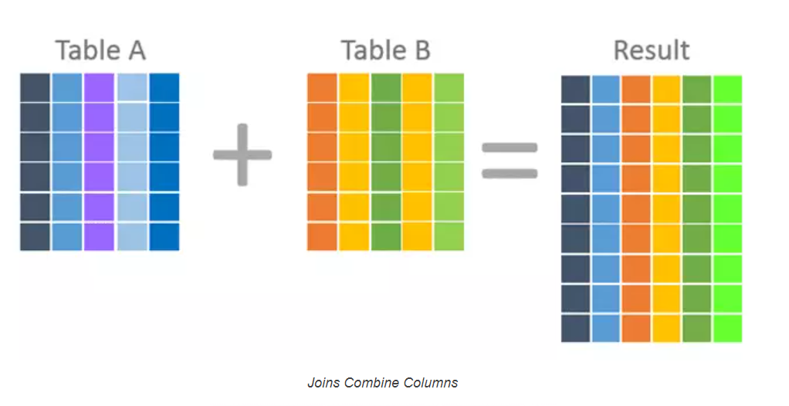
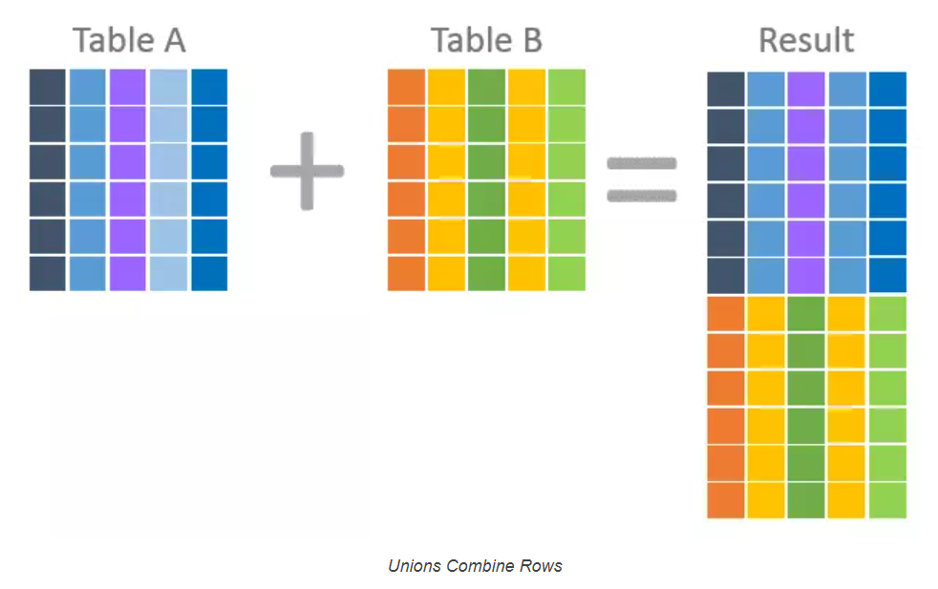
Set operation or join
https://www.essentialsql.com/what-is-the-difference-between-a-join-and-a-union/

Slide 15
Set Operation
Name All people (Student + Teacher) From Lahore
SELECT CNIC, Name
FROM Student
where Address LIKE '%Lahore%' UNION SELECT CNIC , Name
FROM Teacher
where Address LIKE '%Lahore%’;
Name all Students who are also teaching.
SELECT Name
FROM Student
WHERE CNIC IN (SELECT CNIC
FROM Teacher);
Name all students who are not teaching.
SELECT Name
FROM Student
WHERE CNIC NOT IN (SELECT CNIC
FROM Teacher);
Student
CNIC | Name | Address | GPA | Did
Teacher
CNIC | Name | Address | Salary | Did
Department
ID | Name | Location

Slide 16
Union Compatibility
Two tables must have equal number of attributes.
Each attribute must have same domain.
Name All people (Student + Teacher) From Lahore
SELECT CNIC, Name
FROM Student
where Address LIKE '%Lahore%' UNION SELECT CNIC , Name
FROM Teacher
where Address LIKE '%Lahore%’;

Slide 17
Use of ‘Union’ or ‘OR’
Name the student from Department 3 or GPA >3.
Select Name
from Student
Where did = 3 OR GPA >3;
Name Student or Teachers from Lahore.
SELECT Name
FROM Student
where Address LIKE '%Lahore%' UNION SELECT Name
FROM Teacher
where Address LIKE '%Lahore%';
Student
CNIC | Name | Address | GPA | Did
Teacher
CNIC | Name | Address | Salary | Did
Department
ID | Name | Location

Slide 18
Summary
You can use Join or Sub query (IN Keyword) interchangeably. Both have same results. And both depicts the Set operation INTERSECTION.
Union can be achieved with UNION keyword only.
To have the functionality of minus or Except we need to use NOT IN.

Slide 19
Practice Questions
Show department names in which some workers works with salary> 30,000 or it is located in Stafford.
Show employee ssn’s who are managers but don’t have any dependents.
Show manager name who have no dependents.
Make a list of all project numbers for projects that involve an employee whose last name is smith either as a worker or as a manager of dept who controls the project.
List names of employees who do not work on any project.
Fine the names of all employees who work on atleast one project located in Houston but whose department has not located in Houston.

Slide 20
Practice Questions
Show employee names who are managers and they have at least one dependent.
. Show employee name who are managers but they do not have dependents
Show employee name whose supersssn is same as superssn of either “javed” or “ahmad”.
Show project name on which Aliya is not working.
Show all dependent name of employees working in IT department.
Show employee names who work in research department.
Show project names in which an employee ‘John Smith’ works.
Show all project names which are controlled by a department in which ‘John Smith’ works.
Show employee names who has a supervisor with the same salary as themselves.
Show employee names who do not work on any project.
Show department names which are not controlling any project and has a location in Houston

Slide 21
Show employee names who are managers and they have at least one dependent. nesting
Select fname
From employee
Where ssn in (select mgrssn from department)
And
ssn in (select essn from dependent) ;

Slide 22
Show employee names who are managers and they have at least one dependent. nesting
Select fname
From employee
Where ssn in (select mgrssn
From department
Where mgrssn in ( select essn from dependent));

Slide 23
Show employee names who are managers and they have at least one dependent. nesting
Select fname
From employee join department on mgrssn =ssn
Where ssn in ( select essn from dependent);

Slide 24
Show employee name who are managers but they do not have dependents
Select fname
From employee
Where ssn in (select mgrssn from department)
And
ssn Not in (select essn from dependent) ;

Slide 25
> All
name of all employees with salary greater than all employees of dno = 5.
SELECT Fname , Lname
FROM Employee
WHERE salary > ALL (SELECT salary
FROM EMPLOYEE
WHERE Dno = 5);

Slide 26
> Any
name of all employees with salary greater than any employee of dno = 5.
SELECT Fname , Lname
FROM Employee
WHERE salary > Any (SELECT salary
FROM EMPLOYEE
WHERE Dno = 5);

